Slide 1
Introduction to MS

Slide 2
Definition of MS: MS is a chronic, immune-mediated disease of the CNS characterised by inflammation, demyelination and degenerative changes, leading to neurological symptoms and accumulating disability^{1,2}
CNS, central nervous system. 1. Montalban X. et al. Mult Scler. 2018;24:96–120; 2. Practice guideline: Disease-modifying therapies for adults with multiple sclerosis. https://www.aan.com/Guidelines/home/GetGuidelineContent/904. Accessed January 2020.

Slide 3
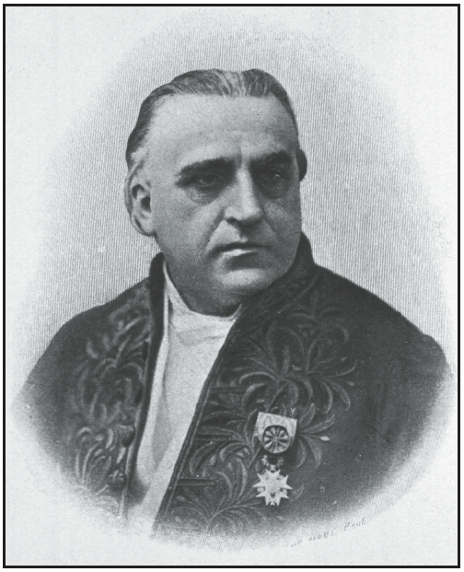
MS is a chronic, neuroinflammatory, neurodegenerative disease of the CNS
MS was first defined clinically in 1868 by Jean-Martin Charcot, the “Father of Neurology”, who described cadavers showing signs of la sclérose en plaques – scarring of the nerves¹
Charcot was the first person to diagnose MS in a living patient and developed a crude diagnostic triad:¹
Jean-Martin Charcot¹
Nystagmus (involuntary, rapid movements of the eyes)²
Intention tremor (tremor occurring during target-directed movement)³
Scanning speech (excess and equal stress on syllables during speech)⁴
While these symptoms are not necessarily diagnostic by modern standards, they do provide a basic outline of the most common symptoms of MS¹
CNS, central nervous system. 1. Kumar DR, et al. Clin Med Res. 2011;9:46–9; 2. Serra A, et al. Front Neurol. 2018;9:31; 3. Koch M, et al. J Neurol. 2007;254:133–45; 4. Hartelius L, Nord L. Folia Phoniatr Logop. 2000;52:228–38

Slide 4
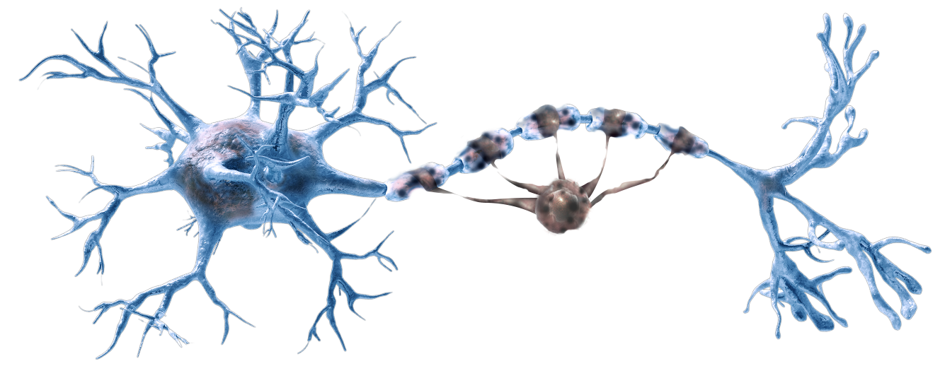
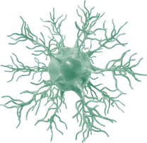
MS is driven by an immune-mediated, inflammatory response
MS is characterised by the destruction of the conductive myelin sheath* by inflammatory autoreactive immune cells. This results in the accumulation of lesions, reduced conductivity of nervous electrical signals and significant, irreversible, axon damage¹
Demyelinated neurone resulting in impaired conduction:¹
Damaged myelin
sheath
Cell body
Autoreactive immune cell
Axon
Fast-forward
Impaired conduction
Further information on MS pathophysiology can be found in module 1.2
*The myelin sheath is an electrically insulating layer of lipids and proteins that allows CNS nerves to increase conduction velocity² Bruck W. J Neurol 2005;252:v3–v9; 2. Stassart RM, et al. Front Neurosci 2018;12:467.

Slide 5
MS is characterised by both acute and chronic disease activity, manifesting as relapses and long-term disability progression
MS is the most common non-traumatic cause of neurological disability in young adults^{1,2}
Acute and chronic disease activity is common in the absence of clinical symptoms^{3,4}
Once a threshold of irreversible disability has been reached, it may be too late for patients to benefit from treatment^{2,5–8}
Treating earlier may reverse some aspects of early dysfunction^{2,9}
1. Conway D, Cohen JA. Lancet Neurol 2010;9:299–308; 2. Compston A, Coles A. Lancet 2002;359:1221–31; 3. Miller DH, et al. Mult Scler 2008;14:1157–74; 4. Río J, et al. Nat Rev Neurol 2009;5:553–60; 5. Confavreux C, et al. N Engl J Med 2000;343:1430‒8; 6. Leray E, et al. Brain 2010;133:1900–13; 7. Coles AJ, et al. Ann Neurol 1999;46:296–304; 8. Coles AJ, et al. J Neurol 2006;253:98–108; 9. Narayanan S, et al. J Neurol 2001;248:979–86.

Slide 6
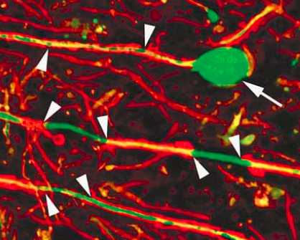
Neuropathology of MS Quiz answers
Pathological mechanisms driving focal white matter injury in MS
Clinical outcomes
Inflammation
BBB disruption
Demyelination
Axonal damage
CNS atrophy
Clinical progression
Acute relapse
BBB, blood–brain barrier; CNS, central nervous system. 1. Filippi M, et al. Handbook of Clinical Neurology 2014;122:115–49; 2. Giovannoni G, et al. Mult Scler Relat Disord 2016;9:S5–48; 3. Bermel RA, Bakshi R. Lancet Neurol 2006;5:158–70; 4. Trapp BD, et al. N Engl J Med 1998;338:278–85.

Slide 7
The neuropathology of MS is the result of a complex interplay of acute and chronic mechanisms that vary over time
RRMS
Progressive MS
Acute inflammation
Chronic inflammation
Acute inflammation
BBB disturbance
New waves of lymphocytes entering the CNS
Adaptive and innate immune drivers of injury
New classical active lesions
Chronic/trapped inflammation
Slow expansion of pre-existing lesions
Chronic activation of microglia
Meningeal inflammatory aggregates
Diffuse white matter injury and brain atrophy
We still don’t have a full picture of MS neuropathology, but increasingly we see evidence of chronic inflammation in both RMS and PMS
Fast-forward
For discussion of pathology beyond acute, focal white matter lesions, skip ahead to Module 4.5 Understanding Disease Progression
BBB, blood–brain barrier; CNS, central nervous system; RRMS, relapsing-remitting MS. Adapted from Lassmann H, et al. Nat Rev Neurol 2012;8:647–56.
Notes:
Key neuropathological processes in MS are permitted by a compromised blood–brain barrier
Immune cells infiltrate the CNS and break down the myelin sheath of axons via autoimmune processes, leading to impaired neuronal function
B cells play a central role in the autoimmune processes of MS, via antigen presentation, and antibody and cytokine production
Associated neurodegenerative processes that lead to axonal loss include acute and chronic inflammation
Although there are some differences in the neuropathological processes evident in RMS and PMS, chronic inflammation is a component of progression throughout the course of all MS phenotypes
This provides further rationale for intervening with disease-modifying therapy to suppress acute and chronic inflammation across the MS continuum and prevent disease progression

Slide 8
MS relapses are variable, unpredictable and highly disruptive for patients
Symptoms of MS (% prevalence in MS)^{5–8}
A relapse presents clinically as an episode of neurological disturbance in the absence of fever or infection, that lasts for at least 24 hours^{1,2}
The relatively sudden onset of neurological symptoms may be functionally and socially incapacitating^{3,4}
A relapse evolves over a few days, plateaus, then remits over a few weeks or months⁴
Relapses may be followed by periods of recovery and be spread over time, or they may occur without full recovery¹
Depression
(31%)⁸
Cognitive issues (≥50%)^{5,6}
Sensory inc. vision problems (85%)⁶
Fatigue (83%⁵)
Pain (54–67%)^{5,7}
Bowel/bladder dysfunction (34%/60%)⁵
Mobility impairment (90%)⁵
Sexual dysfunction (31%)⁵
Walking difficulty (67%)⁵
Spasms/stiffness (63%)⁵
The most common symptoms of MS include fatigue, impaired mobility and sensory disturbances,^{5,6} but loss of normal neuronal function throughout the CNS can also lead to seizures, sexual dysfunction and speech problems⁵
CNS, central nervous system. 1. Thompson AJ, et al. Lancet Neurol 2018;17:162–73; 2. Poser CM, et al. Ann Neurol 1983;13:227–31; 3. Vollmer T. J Neurol Sci 2007;256:S5–13; 4. Leary SM, et al. Postgrad Med J 2005;81:302–8. 5. Zwibel HL. Adv Ther 2009;26:1043–57; 6. Kister I, et al. Int J MS Care 2013;15:146–58; 7. Rae–Grant AD, et al. Mult Scler 1999:5:179–83; 8. Boeschoten RE, et al. J Neurol Sci. 2017;372:331–41.

Slide 9
Exploring the role of the immune system in the neuropathology of MS

Slide 10
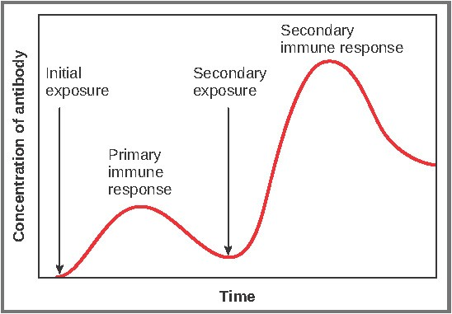
Overview of a typical immune response to pathogens
Innate immunity
Adaptive immunity
Innate response
Antigen presentation
Adaptive response
Response resolution
The immune response follows a typical path over time in response to pathogens

Slide 11
Overview of a typical immune response to pathogens
Innate immunity
Adaptive immunity
Innate response
Antigen presentation
Adaptive response
Response resolution
A fast, non-specific defence against pathogens (disease-causing microorganisms), comprised of first responder cells and proteins. Typically involves inflammation, pathogen killing and cell recruitment¹.
This is the link between the innate and adaptive immune responses. After innate response cells contact invader, or “antigen”, the antigen is presented to the cells of the adaptive immune system in order to continue the fight against an invader that has not been eradicated¹.
A slower but longer-lasting and specific defence composed of lymphocytes (B and T cells). T cells both attack the invader and signal B cell production. B cells recognise the antigen and proliferate, differentiating into antibody-producing plasma cells¹.
Once an infection is eradicated, the immune system self-regulated to shut down the response and prevent host damage². A portion of B cells will remain as memory cells to rapidly reactivate for the same antigen and some plasma cells survive for long periods as a source of antibodies¹.
Antigens are any molecule, such as a protein, that elicit an immune response and they can be present on both pathogens and healthy cells in the human body. Autoimmune diseases, such as MS, are caused by inappropriate immune responses to antigens on healthy human cells (called “self-antigens”), which are normally ignored by the immune system.³
In the currently accepted pathogenesis of MS^{3,4}, this response is targeted at the CNS. Lymphocytes cross the BBB and activate within the CNS, with B cells differentiating into autoantibody-producing plasma cells. These cells destroy the myelin sheath on neuronal axons and damage the neurons themselves through toxicity and production of cytokines.
BBB, blood-brain barrier; CNS, central nervous system.
1. Murphy K (2012). Janeway’s Immunobiology. 8th Ed. Garland Science; 2. Sompayrac L (2008). How the Immune System Works. 3rd Ed. Blackwell Publishing;
3. Coyle PK (2011). MS: Pathology and Immunology. In Rizvi SA, Coyle PK (Eds.) Clinical Neuroimmunology: Multiple Sclerosis and Related Disorders (pp. 43–70). Humana Press;
4. Bar-Or A. Semin Neurol 2008;28:29–45.

Slide 12
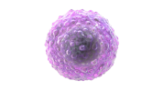
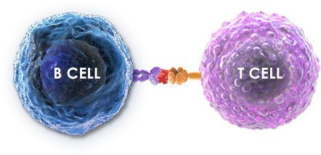
B- and T-cell interactions are critical in healthy immune responses resulting in the removal of pathogens
B cells provide signals to promote T-cell responses^{1,2}
IL-6
IL-10
LTα
TGF-β TNF-α
T-cell expansion⁵
Foreign antigen
IL-4
IL-5
IL-10
IL-21
T cells provide “help” to B cells through the delivery of cytokines¹⁻⁴
Healthy proliferative response to a foreign antigen, results in effector-mediated killing of pathogens^{6,7}
IL, interleukin; LT, lymphotoxin; TGF, transforming growth factor; TNF, tumour necrosis factor.
1. Edwards JC, Cambridge G. Nat Rev Immunol 2006;394–403; 2. Lund FE. Curr Opin Immunol 2008;20:332–8; 3. Varzaneh FN, et al. J Clin Immunol 2014;34:524-43;
4. Kuchen S, et al. J Immunol 2007;179:5886–96; 5. Chan OT, et al. J Exp Med 1999;189:1639–47; 6. Ireland SJ, et al. Autoimmunity 2012;45:400–14; 7. Hauser SL. Mult Scler 2015;21:8–21.
Notes:
Edwards 2006, pg394/col1/para3/ln10-11/col2/para1
/ln1-5&pg395/Fig1&pg396/Fig3
Lund 2008, pg2/para3/ln8-10
Edwards 2006,
pg394/col1-
2/para3-1/ln10-
11,15&pg395/Fig1
&pg396/Fig3&pg40
1/col2/ln6-8
Lund 2008,
pg1/Intro/para2/ln6-
8&pg2/para1/ln1-3,
para3/ln8-
10&pg4/para3/ln1-
2&pg5/Conclusions/l
n1-4
Kuchen 2007,
pg5889/col2/para
1/ln4-
6&pg5890/col2/p
ara 3/ln1-15
Chan 1999, pg1641/col1/para2/ln12-15/ pg1642/Fig3E leg/ln9-14
Ireland 2012, pg403/Fig3
Hauser 2015, pg12/col2/para2/p13/col1/para1 and para2)/para3/ln2-7/ln16-21/ pg13/pg14/Fig5/legend
Varzaneh 2014,
pg534/col1/IL-4 para
6/ln1-4, col2/IL-5,
para 7
/ln1&pg535/col2/IL-
10, para 2/ln1-
5&pg536/col1/IL-21,
para 4/ln3-5

Slide 13
B- and T-cell interactions abnormally respond to self neuroantigens in MS, resulting in autoimmunity
B cells provide signals to promote T-cell responses^{1,2}
IL-6
IL-10
LTα
TGF-β TNF-α
T-cell expansion⁵
Self neuroantigen
IL-4
IL-5
IL-10
IL-21
T cells provide “help” to B cells through the delivery of cytokines¹⁻⁴
An autoreactive response to self neuroantigens results in the degradation of components of the CNS⁶
IL, interleukin; LT, lymphotoxin; TGF, transforming growth factor; TNF, tumour necrosis factor.
1. Edwards JC, Cambridge G. Nat Rev Immunol 2006;394–403; 2. Lund FE. Curr Opin Immunol 2008;20:332–8; 3. Varzaneh FN, et al. J Clin Immunol 2014;34:524-43;
4. Kuchen S, et al. J Immunol 2007;179:5886–96; 5. Chan OT, et al. J Exp Med 1999;189:1639–47; 6. Ireland SJ, et al. Autoimmunity 2012;45:400–14; 7. Hauser SL. Mult Scler 2015;21:8–21.
Notes:
Edwards 2006, pg394/col1/para3/ln10-11/col2/para1
/ln1-5&pg395/Fig1&pg396/Fig3
Lund 2008, pg2/para3/ln8-10
Edwards 2006,
pg394/col1-
2/para3-1/ln10-
11,15&pg395/Fig1
&pg396/Fig3&pg40
1/col2/ln6-8
Lund 2008,
pg1/Intro/para2/ln6-
8&pg2/para1/ln1-3,
para3/ln8-
10&pg4/para3/ln1-
2&pg5/Conclusions/l
n1-4
Kuchen 2007,
pg5889/col2/para
1/ln4-
6&pg5890/col2/p
ara 3/ln1-15
Chan 1999, pg1641/col1/para2/ln12-15/ pg1642/Fig3E leg/ln9-14
Ireland 2012, pg403/Fig3
Hauser 2015, pg12/col2/para2/p13/col1/para1 and para2)/para3/ln2-7/ln16-21/ pg13/pg14/Fig5/legend
Varzaneh 2014,
pg534/col1/IL-4 para
6/ln1-4, col2/IL-5,
para 7
/ln1&pg535/col2/IL-
10, para 2/ln1-
5&pg536/col1/IL-21,
para 4/ln3-5

Slide 14
In immune-mediated diseases, the processes normally preventing the activation of autoreactive B and T cells are dysfunctional
There are four potential hypotheses for the activation autoreactive B and T cells:
Molecular mimicry
Novel autoantigen presentation
Foreign antigens share sequence or structural homology with self-antigens leading to the production of self-reactive T cells.¹
Citrullination of proteins expands the repertoire of epitopes after protein immunisation. Citrullination is increased during inflammation, potentially leading to novel autoantigen presentation.²
Recognition of sequestered antigens
Bystander activation
Self-reactive T cells are produced in response to sequestered autoantigens released to the periphery following a viral infection.³
Autoreactive cells are activated during infection due to nonspecific inflammatory events.¹
Once the immune system has targeted an autoantigen to the CNS, the antigen is never removed and results in a continuous cycle of inflammation and damage
1. Sospedra M, Martin R. Annu. Rev Immunol 2005;23:683–747; 2. Faigle W, et al .Front Immunol 2019:540; 3. Miller SD, et al. Nature Med 1997;3:1133–6.
Notes:
Citrullination converts arginine to citrulline in proteins.

Slide 15
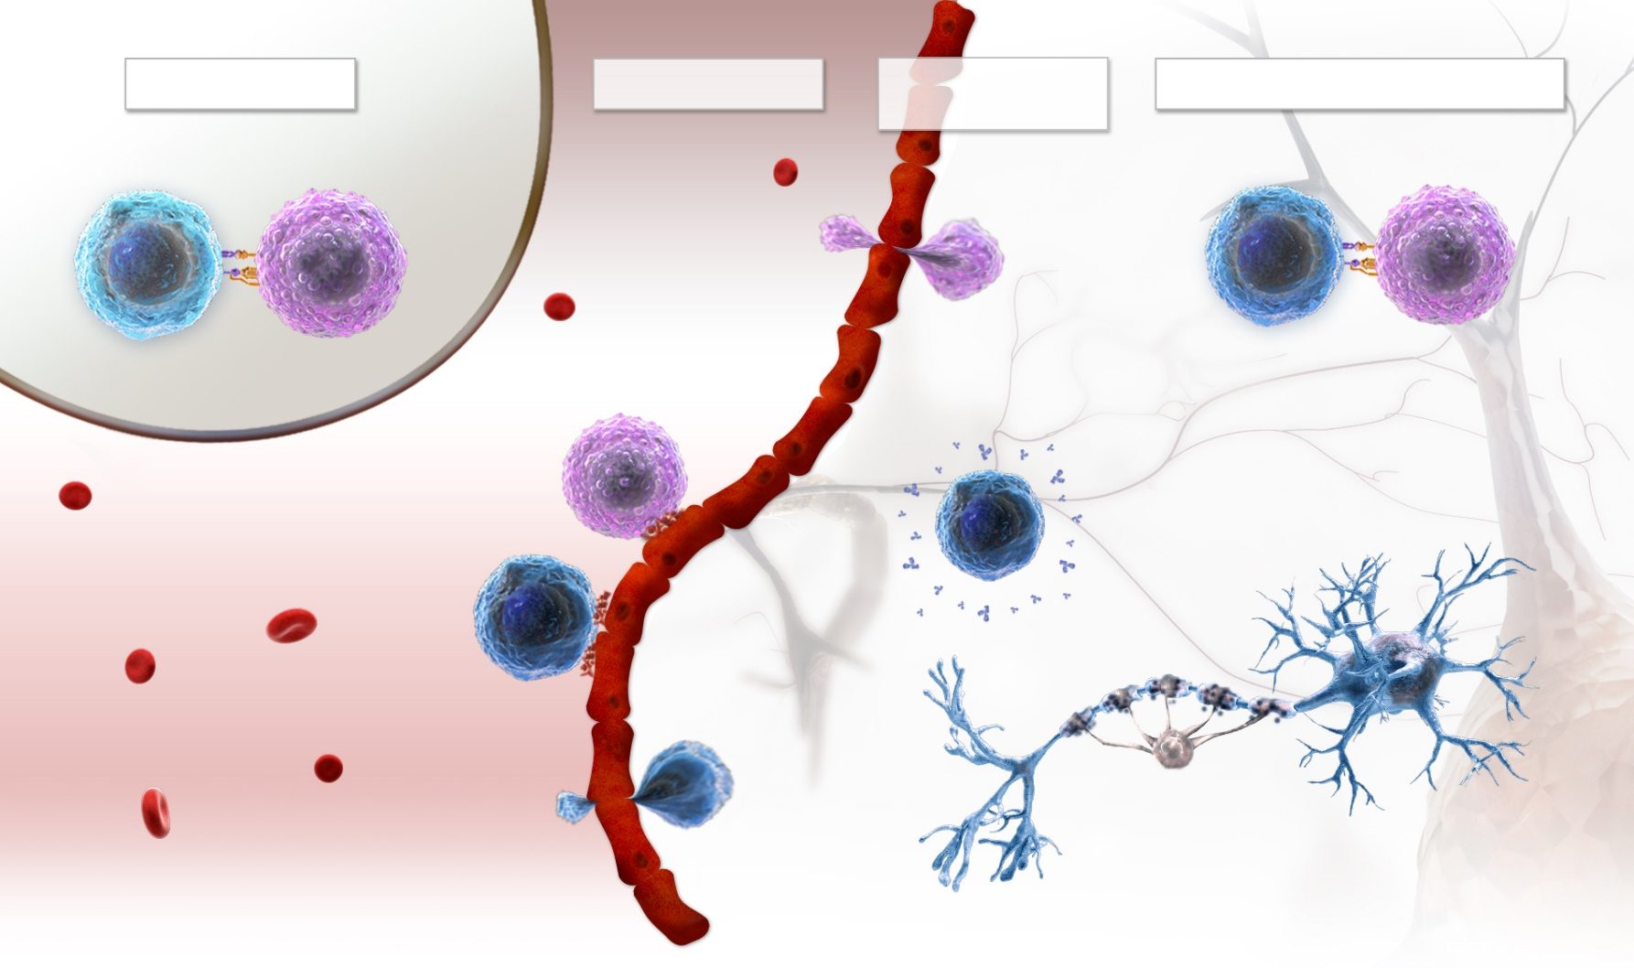
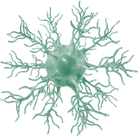
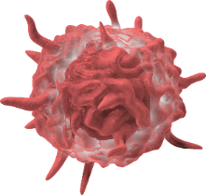
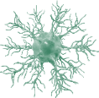
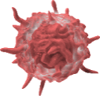
Immune cell infiltration into the CNS in early MS leads to demyelination promoted by microglia and astrocytes
1
Following activation in the periphery, autoreactive T cells and B cells adhered to the CNS move across the BBB^{1,2}
LYMPH NODE
BLOOD VESSEL
BLOOD–BRAIN BARRIER
CENTRAL NERVOUS SYSTEM
B CELL
T CELL
2
1
Lymphocytes undergo another level of activation, mediated by APCs upregulated as part of the inflammatory response^{1,2}
2
3
B CELL
T CELL
Autoreactive lymphocytes, primarily Th1 cells, promote the recruitment and activities of other mediators of damage^{1,2}
T CELL
ANTIBODY RELEASE
4
MICROGLIA
4
B cells differentiate into plasma cells and produce autoantibodies directed against CNS tissue, which causes damage to myelin via opsonisation and activation of the complement cascade³
B CELL
3
5
NEURONAL DAMAGE
Cytotoxic T cells, macrophages and microglia attack and damage myelin, oligodendrocytes, and axons – via a combination of direct and indirect mechanisms¹
5
MACROPHAGE
APC, antigen-presenting cell; BBB, blood–brain barrier; CNS, central nervous system; Th, T helper cell. 1. Bar-Or A. Semin Neurol 2008;28:29–45; 2. Dendrou CA, et al. Nat Rev Immunol 2015;15:545–58; 3. Weber MS, et al. Biochim Biophys Acta 2011;1812:239–45.
Notes:
Mechanisms of Injury in MS
Activated CNS-resident microglia and astrocytes also promote demyelination and oligodendrocyte and neuroaxonal injury through direct cell contact-dependent mechanisms and through the action of soluble inflammatory and neurotoxic mediators

Slide 16
An overview of immune cells and their specific roles in relation to the neuropathology of MS
 |  | Innate |  | Adaptive
Cell types | Macrophages | Microglia | Astrocytes | B cells | T cells
 |  |  |  |  | CD4 | CD8
Hypothesised immune function in MS | Antigen-independent inflammation Immediate response³ Antigen presentation | Cytokine production¹⁴ Increased ROS production Antigen presentation | Cytokine production¹⁷ Recruitment of leukocytes across the BBB Increased ROS production | Antigen presentation¹ Cytokine production² Antibody production (humoral immunity)^{1,3} Formation of lymphoid follicles* that potentiate selective immune cell formation^{1–6} Enhanced response by repeated antigen exposure (memory)³ | Helper T cell⁷ Concentrated in the perivascular cuff⁷ Cytokine production⁸ Co-stimulation of B cells Enhanced response by repeated antigen exposure (memory)³ | Cytotoxic T cell⁷ Widely distributed within the parenchyma⁷ Antigen-dependent cell-mediated cytotoxicity Cytokine production² Enhanced response by repeated antigen exposure (memory)³
Cytokines released when activated | IL-1β, TNF-α, IFN-γ¹² | IL-1β, IL-6, TNF-α¹⁵ | IL-1β, IL-6, IL-10, TNF-α¹⁷ | IFN-γ, IL-6, IL-10¹² | IL-10, TGF-β, IL-4, IL-17, IL-21, IL-22, IFN-γ¹⁰ | IL-17, IFN-γ, GM-CSF, TNF, TGF-β¹¹
Cell surface markers | CD40, CD86, FcγRI (CD64), FcγRII (CD32)¹³ | CD11b, F4/80, CD115, MHC-II, CD45, CD11c CD68¹⁶ | MHC-II, CD11a, CD54, CD80, CD86¹⁷ | CD19, CD20, CD52, α4-Intergrin, BAFF-R⁹ | NKG2C, CD56, NKG2D, granzyme B¹¹ | MCAM, CD25, CD122, CD56¹¹
*Usually in lymphoid tissue, but ectopic lymphoid follicles can be found in the brains of patients with MS^{5,6} BBB, blood-brain barrier; GM-CSF, granulocyte macrophage colony stimulating factor; IFN, interferon; IL, interleukin; MCAM, melanoma cell adhesion module; MHC, major histocompatibility complex; ROS, ; TNF, tumour necrosis factor.
1. Parkin J, Cohen B. Lancet 2001;357:1777–89; 2. LeBien TW, Tedder TF. Blood 2008;112:1570–80; 3. Warrington R, et al. Allergy Asthma Clin Immunol 2011;7:S1; 4. Chaplin DD. J Allergy Clin Immunol 2010;125:S3–23;
5. Serafini B, et al. Brain Pathol 2004;14:164–74; 6. Magliozzi R, et al. Ann Neurol 2010;68:477–93; 7. Reich DS, et al. N Engl J Med 2018;378:169–80; 8. Delves P, Roitt I. N Engl J Med 2000;343:37–49;
9. Krumbholz M, et al. Nat Rev Neurol 2012;8:613–23; 10. Fletcher JM, et al. Clin Exp Immunol 2010;162:1–11; 11. Legroux L, Arbour N. J Neuroimmune Pharmacol 2015;10:528–54; 12. Rawji KS, Wee Yong V. Clin Dev Immunol 2013:948–76;
13. Vogel DYS, et al. J Neuroinflammation 2013;35; 14. Carson MJ. Glia 2002;40:218–31; 15. Hanisch U. Glia 2002;40:140–55; 16. Greter M, et al. Front Immunol 2015;6:249; 17. Ponath G, et al. Front Immunol 2018;9:217.

Slide 17
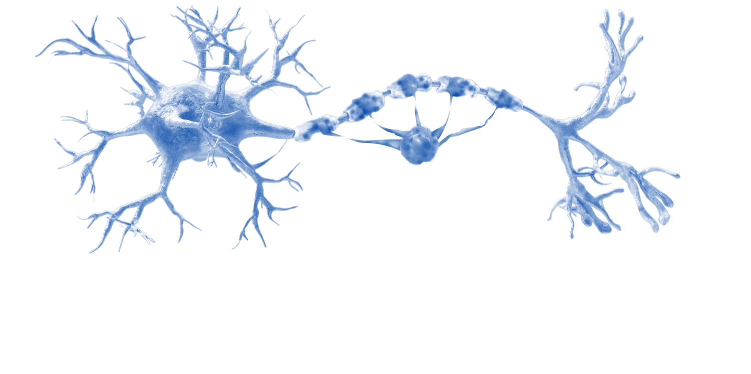
T cells play key roles in acute inflammation in MS via the recruitment of additional pro-inflammatory cells to the CNS
Pro-inflammatory cytokine production primarily by CD4+ Th1 cells, e.g. production of IFN-γ
and TNF-α, which drives other effector cells²
Co-stimulatory activation of B cells
CD4⁺
Recruitment of pro-inflammatory cells by CD4+ Th1 cells promotes CNS infiltration of lymphocytes and recruits pro-inflammatory microglia and macrophages¹
CD8⁺ T CELL
Direct cell-mediated damage by CD8+ cytotoxic T cells, which are unregulated by Th1 cells, and directly recognise driving antigens resulting in cell-mediated damage to myelin, oligodendrocytes and axons²
CNS, central nervous system; IFN, interferon; Th, T helper cell; TNF, tumour necrosis factor. 1. Dendrou CA, et al. Nat Rev Immunol 2015;15:545–58; 2. Filippi M, et al. Nat Rev Dis Primers 2018;4:43.
Notes:
Mechanisms of Injury in MS
B and T cells work together through co-stimulatory activation
T cells secrete pro-inflammatory effectors that allow infiltration of the CNS through the BBB

Slide 18
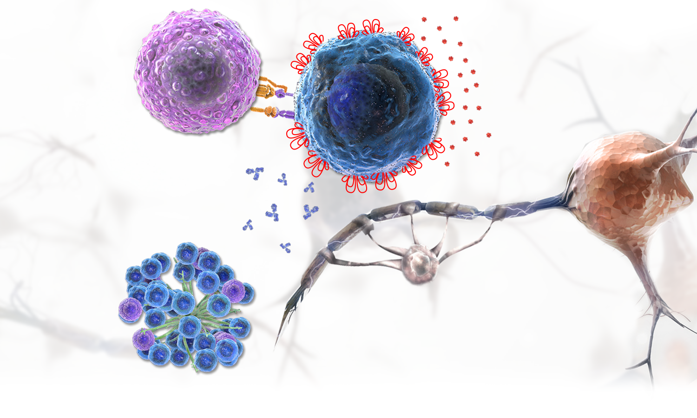
B cells activate T cells, produce cytokines and autoantibodies and are present in ectopic lymphoid follicle-like aggregates
Production of cytokines,^{2,3} some of which are cytotoxic to oligodendrocytes and neurons⁴
Antigen presentation activates T cells^{1,2}
T CELL
CD20⁺ B CELL
Production of autoantibodies,⁵ which promote tissue injury² and drive lymphoid aggregate formation⁶
NEURON
OLIGODENDROCYTE
Fast-forward
Ectopic lymphoid follicle-like aggregates maintain the autoreactive responses in close proximity to the target tissues^{6,7}
Driver of chronic inflammation (mostly seen in SPMS)
Further information on the B cells can be found in module 3.1
SPMS, secondary progressive MS. 1. Crawford A, et al. J Immunol 2006;176:3498–506; 2. Bar-Or A, et al. Ann Neurol 2010;67:452–6; 3. Lisak RP, et al. J Neuroimmunol 2012;246:85–95; 4. Lisak RP, et al. J Neuroimmunol 2017;309:88–99; 5. Weber MS, et al. Biochim Biophys Acta 2011;1812:239–45; 6. Serafini B, et al. Brain Pathol 2004;14:164–74; 7. Magliozzi R, et al. Ann Neurol 2010;68:477–93.
Notes:
Antigen presentation: Memory B cells can present self neuroantigens to T cells and activate them.
Preclinical models suggest that, via antigen presentation and co-stimulation, autoreactive B cells in the CNS may activate T cells for a pro-inflammatory response^{1,2}
Cytokine production: B cells in patients with MS produce abnormal pro-inflammatory cytokines, which can activate T cells and other immune cells
B cells in patients with MS tend to produce more pro-inflammatory cytokines and less protective cytokines compared with healthy controls^{2,3}
Autoantibody production: B cells produce autoantibodies that mediate tissue damage and activate macrophages and NK cells
Preclinical data indicate that B cells can differentiate into plasma cells, producing autoantibodies which may bind to myelin sheaths and oligodendrocytes and promote tissue injury²⁻⁵
B-cell antibodies can also activate macrophages and NK cells⁴⁻⁶
Ectopic lymphoid follicle-like aggregates: B cells are present in ectopic lymphoid follicle-like aggregates, linked to microglia activation, local inflammation, and neuronal loss in the nearby cortex
In patients with progressive MS, ectopic lymphoid structures can form in the meninges^{4,6}
These structures have been linked to microglial activation, local inflammation, and neuronal loss in the nearby cortex^{7,8}
Evolution of acute injury to chronic inflammation
After the acute phase, immune cell infiltration wanes, possibly due to adaptive immune cell exhaustion from chronic antigen exposure. However, chronic CNS-intrinsic inflammation and neurodegeneration continue
B cells can accumulate in the CNS over longer periods of time, with tertiary lymphoid-like structures found commonly in the meninges and cortex which may contribute to late-stage inflammation in secondary progressive MS
From: TtT7 Dal-Bianco plenary draft 0.2 01May2018.pptx

Slide 19
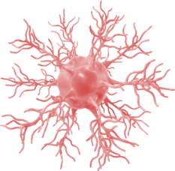
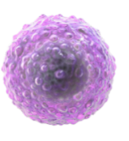
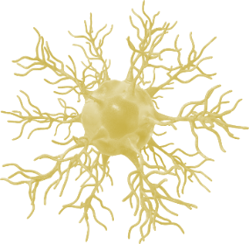
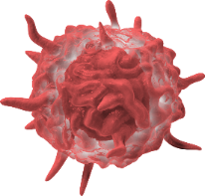
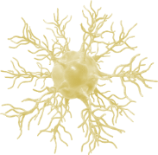
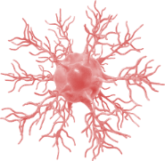
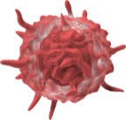
Microglia and macrophages of the innate immune system also play key roles in both acute and chronic inflammation
Antigen presentation recruiting and activating lymphocytes in the CNS^{1,2}
T cell
B cell
T cell
Microglia
Pro-inflammatory cytokines
Macrophages
Astrocytes
Production of pro-inflammatory mediators including cytokines, free radicals and proteases¹
Acute direct cell-mediated damage via phagocytosis of the myelin sheath, resulting in denuding of axons¹
Phagocytosis and oxidative injury by activated microglia at the rim of chronic active lesions²
Driver of chronic inflammation
CNS, central nervous system.
1. Dendrou CA, et al. Nat Rev Immunol 2015;15:545–58; 2. Filippi M, et al. Nat Rev Dis Primers 2018;4:43.
Notes:
Mechanisms of Injury in MS: Evolution of acute injury to chronic inflammation
Contrary to the massive, rapid axonal damage that accompanies acute focal inflammation, chronic neurodegeneration may be associated with chronic inflammation. Macrophages and microglia can continue to cause inflammation trapped behind a repaired BBB, thereby contributing to chronic inflammation in patients with MS.
Inflammation and secondary neurodegeneration
As described previously, damage to the myelin sheath of neurons leads to axonal injury. Although demyelination with loss of trophic support from oligodendrocytes contributes to axonal degradation, axonal and neuronal injury also occurs without demyelination
Reactive oxygen and nitrogen species produced by macrophages and microglia lead to oxidative stress, and this, along with hypoxia, leads to mitochondrial damage and dysfunction. Excess glutamate leads to a calcium influx and these pathways converge to create an energy deficiency and redistribution of ion channels
This leads to calcium and sodium overload within neurons and activation of degrading enzymes and oncotic cell swelling
Finally, this results in neuroaxonal damage by apoptosis and necrosis
Secondary neurodegeneration can occur as a result of acute inflammation as well as repeated inflammatory insults in the CNS.

